Slide 1
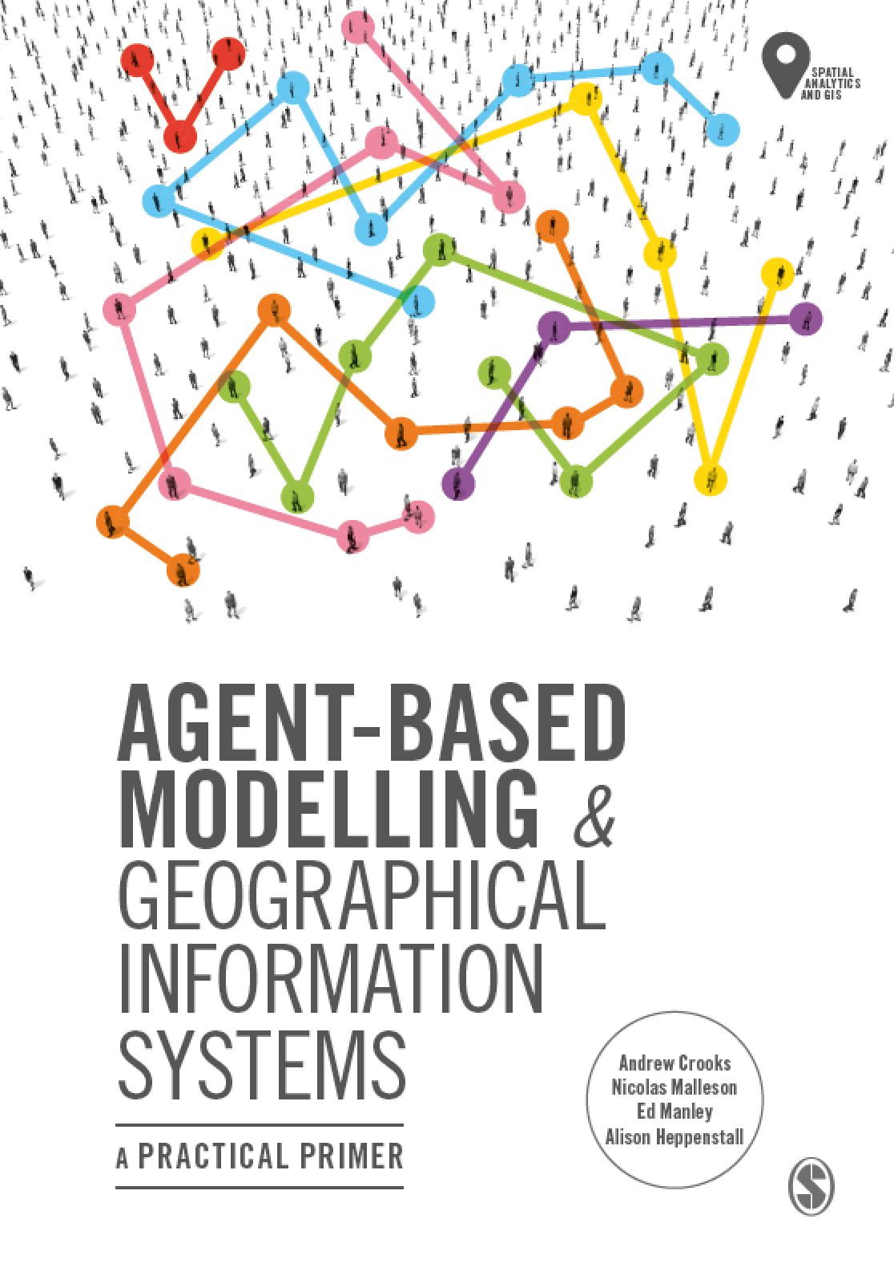
Chapter 3 Tutorial
Designing and Developing an Agent-based
Model
Notes:
Model evaluation is one of the central challenges associated with agent-based models. A key question that all modelers face is “how well does this model simulate the phenomenon of interest?”. While there are no universally accepted methods for evaluating agent-based models, researchers often adopt the same three stage process of verification, calibration and validation. This chapter presents an overview of the methods that are commonly used within each of these stages. The overarching aim of this chapter is to provide the reader with the knowledge to design their own approach to evaluating agent-based models.

Slide 2
Learning Objectives
By the end of this practical lab you will be able to:
Understand how to set up NetLogo
Run a basic ABM
Understand how altering a parameter can impact a model.

Slide 3
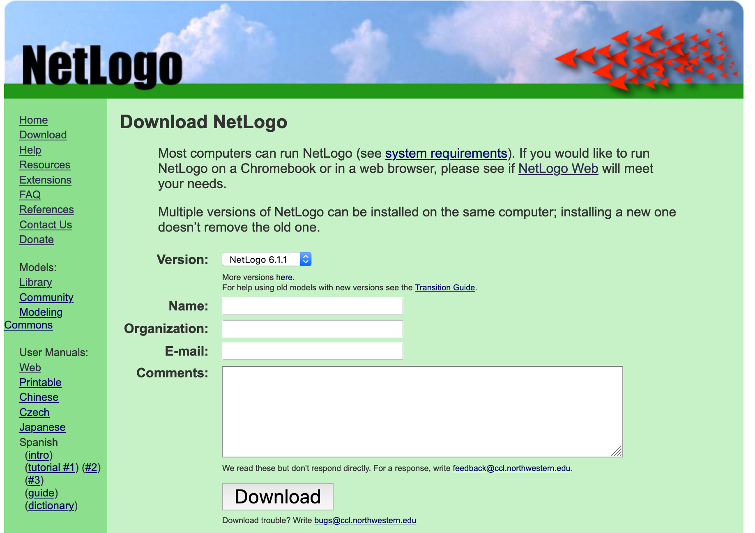
Install NetLogo
Go to https://ccl.northwestern.edu/netlogo/download.shtml

Slide 4
Design Framework
In this book, we introduce a loose framework for ABM design, set into four levels of hierarchy:
Overview – Relating broadly to the wider aims and definitions of the simulation as well as practical considerations
World – Involved with designing the model of the world in which the simulation will take place
Interactions – Design of the nature of interaction and exchange between agents, and the impact on model dynamics
Agents – How agent behavior is designed and encoded at the individual level
Each stage leads to decisions that influence subsequent designs, thus it is advised that this process is conducted in this order

Slide 5
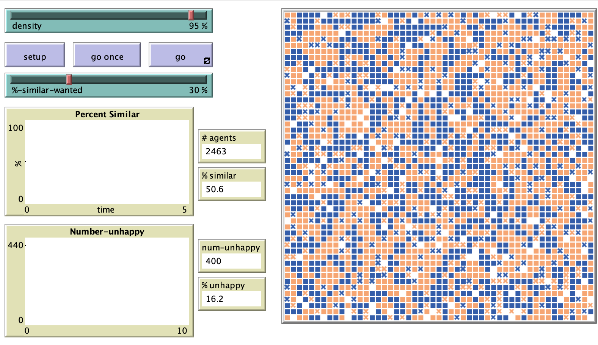
Building a Segregation Model
Schelling’s (1971) Dynamic Model of Segregation
Segregation that results from discriminatory behavior (2 groups)
Race, Religion, Gender, …
Spatial proximity to other agents impacts model results
Individual agents care only about the composition of their own local neighborhood
The model, as implemented by Wilensky (1997a), is available in the NetLogo Models Library, under Sample Models -> Social Science -> Segregation.
Schelling, T.C. (1971), 'Dynamic Models of Segregation', Journal of Mathematical Sociology, 1(1): 143-186.

Slide 6
Segregation Model: Overview
Purpose and process
Simulates the process by which spatial clusters of similar agents form over time
Via the actions of, individual decision-makers.
Agents remain (in which case they are satisfied) or move (when they are unhappy)
Results in aggregate patterns of segregation.
;; unhappy turtles try a new spot
to move-unhappy-turtles
ask turtles with [ not happy? ]
[ find-new-spot ]
end

Slide 7
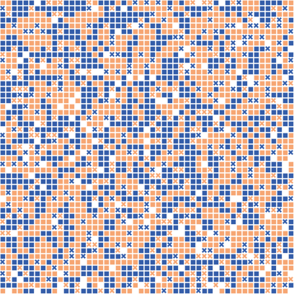
Segregation Model: Overview
Data Collection and Evaluation Plan
The segregation model is typically deployed within a hypothetical context to explore the fundamental dynamics of behavior choice and segregation, rather than in an empirical setting. The hypothetical approach will be maintained here.

Slide 8
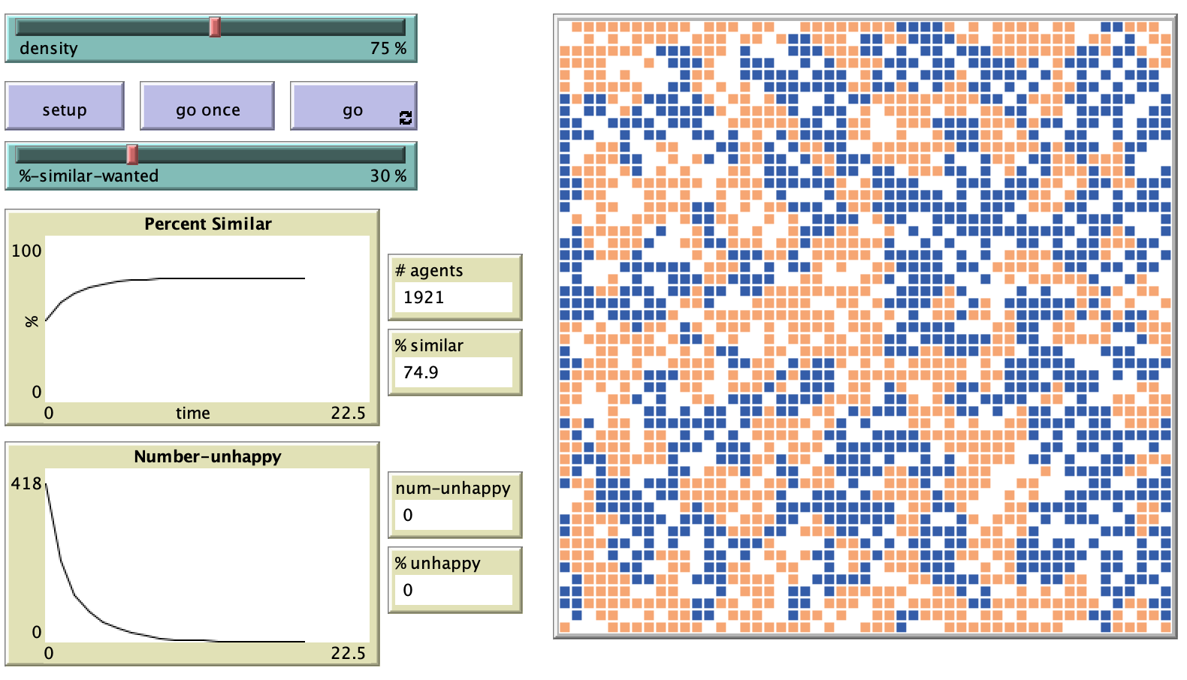
Segregation Model: Overview
Visualization
As the focus is on the emergence of spatial clusters and the effect of agent contentment, visualizations will incorporate both of these aspects.
A map visualization will show how the distribution of the different types of agents evolves over time,
While charts can be used to show levels of contentment
The code to create the charts is straightforward:
plot count turtles with [not happy?]
Map
Charts

Slide 9
Segregation Model: Overview
Biases, Uncertainty and Assumptions
There are a variety of assumptions and simplifications within the model.
It is assumed that there exists a social and spatial environment where segregation emerges from simple choices relating to nearby agents at the expense of other factors.
This reduced complexity allows a clarity of understanding of the possible drivers of segregation that would be more difficult to isolate in a more complex model.
The aim is not to predict real-world phenomena, but rather to focus on the potential impacts of different behaviors on possible segregation patterns.

Slide 10
Segregation Model: World
External Systems
This simulation is not set within a real-world context, so the degree of interaction with external systems can be controlled.
In the case of segregation, one could consider including housing markets, birth and death rates, wider social trends and sentiment, etc.
However, through a simplified approach, the focus will be on the dynamics occurring within the simulation space that result from relatively straightforward agent behaviors.

Slide 11
Segregation Model: World
Space:
The representation of space is an important part of a segregation model, as agents use the proximity to different types of agent to assess the suitability of their location.
Given the focus on spatial clusters, without application to a real-world context, the essential choice here relates to either continuous or cellular space.
Continuous space would be suitable if the aim was to allow agents to move unequally across the environment. This would make it possible to represent varying densities of spatial configuration,
Cellular space limits movement to within discrete cells. This creates a less complex environment, but one that is not as easy to equate to a real-world context.
Since the focus here is purely on behavioral dynamics, the simpler cellular space will be used, noting again that the assumptions and limitations are made clear from the beginning.

Slide 12
Segregation Model: World
Time:
Within the modelled environment, the simulation need not proceed in line with any specific unit of time.
The number of simulated iterations (‘ticks’) will be the sole measure of time
No limitations on the length of the simulation – except when all agents are satisfied, in which case the simulation effectively stops.
if all? turtles [ happy? ] [ stop ]

Slide 13
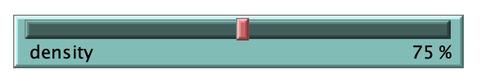
Segregation Model: World
Populations
The agent population is determined through a density parameter, expressed as a percentage of the simulation cells to be inhabited by agents at the start of the simulation.
The parameter is provided for the user to vary (via a slider in the simulation interface) with the aim of exploring the impact of varying density on cluster formation.
Density ranges from 0 (no agents) to 100 (every patch houses an agent) and can be used to spawn agents by testing whether or not a randomly chosen number between 1 and 100 is less than the current density value:
;; create turtles on random patches.
ask patches [
if random 100 < density [ ;; set the occupancy density
sprout 1 [
set color one-of [red green]
]
]
]

Slide 14
Segregation Model: World
Physical Rules
There is an assumption that no two agents can inhabit the same cell at the same time.
Other than that, there are no constraints on movement; every unoccupied cell valid and likely choice for an agent’s destination. The agents is an equally chose a new location by walking randomly over the world until they find a patch that is unoccupied:
;; move until we find an unoccupied spot
to find-new-spot
rt random-float 360
fd random-float 10
if any? other turtles-here [ find-new-spot ] ;; keep going until we find an unoccupied patch
move-to patch-here ;; move to center of patch
end

Slide 15
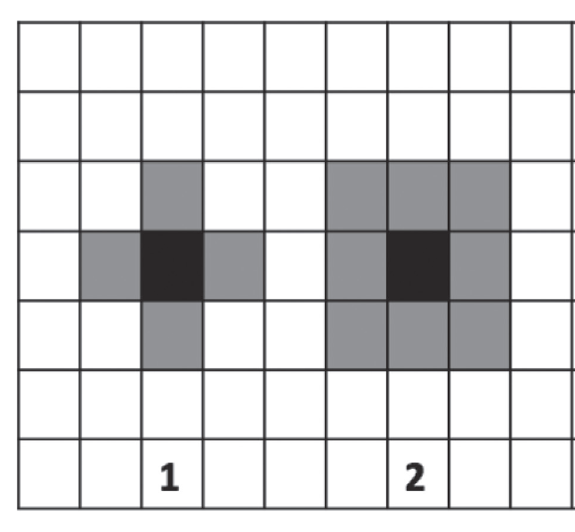
Segregation Model: Interactions
Physical Interactions
In this model, the ‘neighborhood’ is defined as the group of cells that are adjacent to an agent’s current location.
There are two neighborhood definitions that could be used: the Moore (2) or the von Neumann (1) neighborhoods,
Convention suggests using all eight cells, so that is
The approach taken here, is the Moore neighborhood.
In NetLogo, the neighbors and neighbors4 commands return the patches within the Moore and von Neumann neighborhoods, respectively.

Slide 16
Segregation Model: Interactions
Communication
With proximity acting as the main point of interaction, there is no direct interagent communication within this simulation.
This could later be included as a factor affecting the decision to move location.
Resource Exchange
The focus here is on physical interaction, hence resource exchanges are not included.

Slide 17
Segregation Model: Agents
Characteristics
A key characteristic of agents within the segregation model is a ‘type’ indicator, against which each agent can assess similarity.
Two different types are used here, denoted by different colors (‘blue’ and ‘orange’).
Assignment of types to agents is done randomly, with agents receiving an equal chance of being allocated to either type. The following code sets a new agent’s color to either blue or orange.
ask patches [
if random 100 < density [ ;; set the occupancy density
sprout 1 [
set color one-of [blue orange]
]
]
]

Slide 18
Segregation Model: Agents
Characteristics (continued)
A mechanism is also required to determine whether an agent is content with its location.
This is done by setting the proportion of similar agents (e.g. those of the same color) within the agent’s neighborhood that are required for an agent to be content.
This parameter is called %-similar-wanted. There are a number of different approaches for determining the value of this parameter:
Assigning a random value to each agent; drawing from a distribution; deriving the rules from data; or assigning a uniform value to the whole population of agents.
Given the focus on simplicity, a global value is used for this parameter (all agents have the same threshold).

Slide 19
Segregation Model: Agents
Decisions
It has already been established that agents’ decisions to move are based on the presence of other agents in neighboring cells. Therefore the agents need information about the proportion of similar and dissimilar agents nearby.
NetLogo can use the number of similar and dissimilar agents to calculate a proportion, and then make an assessment of contentment by observing whether or not the proportion is less than the %-similar-wanted threshold.
If the proportion of similar neighboring agents is greater than or equal to the %-similar-wanted value, then the agent is judged to be content other wise its not.
ask turtles [
;; in next two lines, we use "neighbors" to test the eight patches
;; surrounding the current patch
set similar-nearby count (turtles-on neighbors) with [ color = [ color ] of myself ]
set other-nearby count (turtles-on neighbors) with [ color != [ color ] of myself ]
set total-nearby similar-nearby + other-nearby
set happy? similar-nearby >= (%-similar-wanted * total-nearby / 100)

Slide 20
Segregation Model: Agents
Actions
The final aspect of behavior to define is what occurs where a decision to move is made. Following a decision to move, the agent is randomly assigned to another cell.
;; move until we find an unoccupied spot
to find-new-spot
rt random-float 360
fd random-float 10
if any? other turtles-here [ find-new-spot ] ;; keep going until we find an unoccupied patch
move-to patch-here ;; move to center of patch
end

Slide 21
Digging Deeper into NetLogo
Turtle
The basic agent in NetLogo
Can age agent specific attributes
Distinct classes of agents can be defined using breeds operator
Capable of moving
Patch
The basic landscape element in NetLogo
Can have patch-­‐speciﬁc attributes
Not capable of moving
Patch variables can be directly accessible by any turtle standing on it
Link
Represents a link between agents
Can have attributes
Can move, but only via being attached to/from other agents
Doesn’t exist except in conjunction with agents

Slide 22
NetLogo Data Structures
Fundamental Types
NetLogo supports numeric types (integer, ﬂoat), character types (string), collections (agentset, list), and Booleans (True/False)
Other more sophisticated data types can be used via importing external libraries (e.g. matrix math library)
Variables
NetLogo is "weakly typed".
Variables can be reassigned diﬀerent types at run time
Variables are not case sensitive
Global Variables (Globals)
Special globally visible variables.
Can be read/written anywhere in the NetLogo program
Local Variables
variables declared and used within the scope of a procedure. Declared using let, assigned using set
Agentset
A set of agents. Unordered "bag” or collection of a group of agents.
Cannot contain subagentsets
List
An ordered list of elements (agents, integers, strings, etc).
Can contain sublists (lists within lists)
Boolean
Variables that can assume only the value True or False

Slide 23
NetLogo Coding Style and Conventions
NetLogo is ﬂexible on variable naming
Pick a consistent style, and stick with it
Use the built-­‐in source code indentation manager (highlight code segment, press "tab")
Some common conventions
Use"‐" as a word separator ("similar-nearby")
Use setup, and go to manage initialization of global variables, setup of model, and model runs
Use breed-­‐speciﬁc preﬁx for breed-­‐speciﬁc procedures
wolf­‐reproduction, bunny‐movement, grass‐regrowth
Booleans end with "?" ( happy )
Use ";" to indicate comments (comments are cheap – use them liberally !)
Example of other conventions you can use
Use all caps for globals (MAX_SALARY)
Use preﬁx to indicate globals managed by interface widgets
INPUT_SLIDER_INITIAL_NUM_BUNNIES
OUTPUT_WOLF_POPULATION_SIZE
Fill in the built-­‐in documentation tab to describe your model
You can add new sections if you want to, NetLogo will automatically format them.

Slide 24
Now Lets Build the Segregation model!

Slide 25
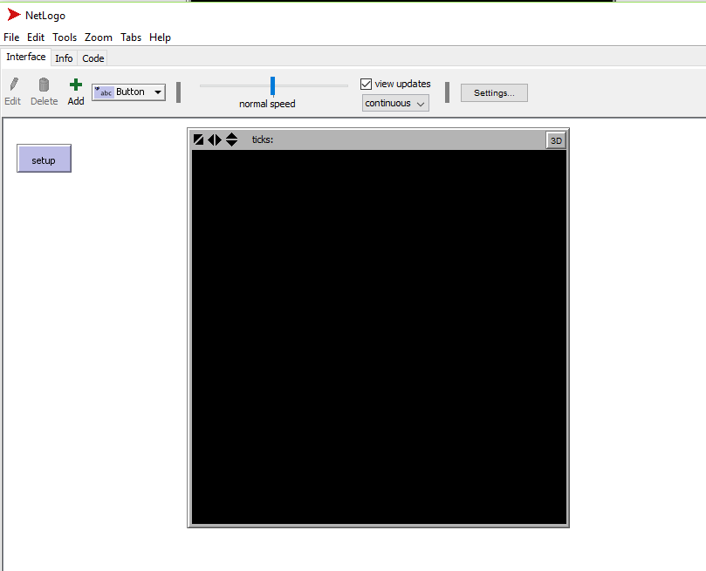
Set up
First open NetLogo
Click on Add
Select Button and click on the top left of the canvas
Type “setup” in the commands and display name
What do we want to achieve at the set up button?
Randomly distribute the agents on the viewers based on the density
Reinstate the system
…

Slide 26
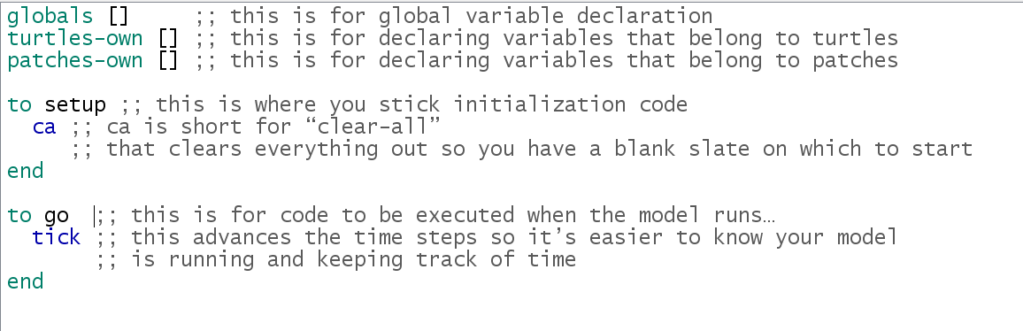
Set up
Select the ‘code’ tab and type the following

Slide 27
Turtles Variables
What are the characteristics of the turtles ?
Happy
Similar neighbors
Others neighbors
Total neighbors

Slide 28
Turtles Variables
What are the characteristics of the turtles ?
Happy, Similar neighbors, Other neighbors, Total neighbors
turtles-own [
happy? ;; for each turtle, indicates whether at least %-similar-wanted percent of
;; that turtle's neighbors are the same color as the turtle
similar-nearby ;; how many neighboring patches have a turtle with my color?
other-nearby ;; how many have a turtle of another color?
total-nearby ;; sum of previous two variables
]
Notes:
Dont forget about tab

Slide 29
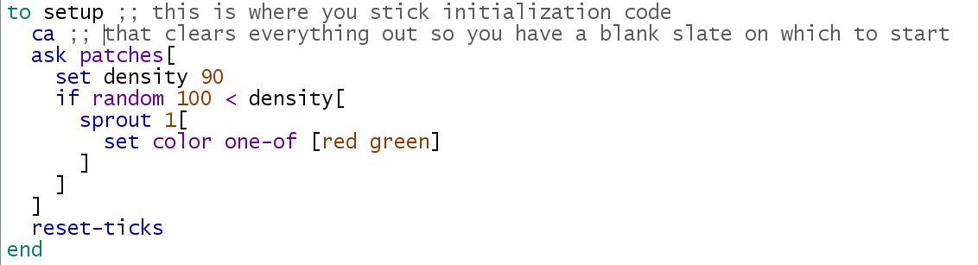
Set Up (2)
Generate random numbers between 1 and 100
Create a new turtle on the current patch
Make the turtle either red or green
Reset ticks

Slide 30
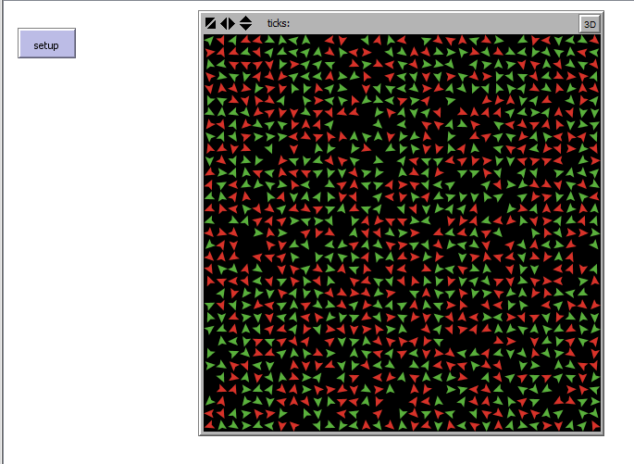
Press Setup

Slide 31
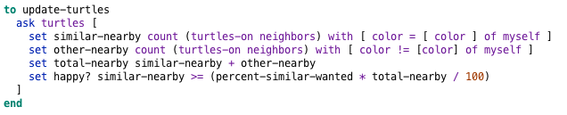
Update Turtles’ Variables
Use neighbors to test 8 patches surrounding each patch
This should be done at the set up
Call update-turtles before resetting the ticks

Slide 32
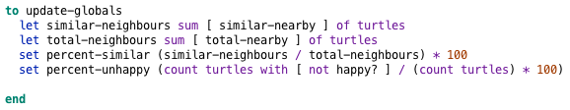
Update Global Variables
After creating the turtles we need to calculate the similar neighbors, the total neighbors and the percentages of similar neighbors and unhappy turtles
This should be done at the set up
Call update-globals before resetting the ticks
Notes:
Here we are setting local variables declared and used within the scope of a procedure.
Declared using let, assigned using set

Slide 33
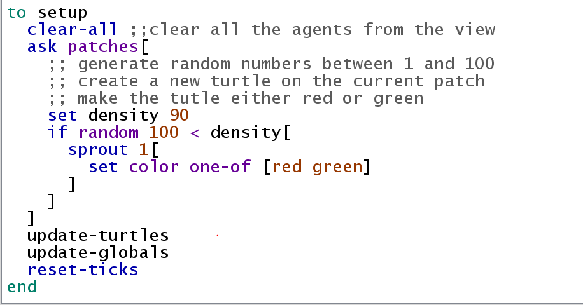
Update Global Variables

Slide 34
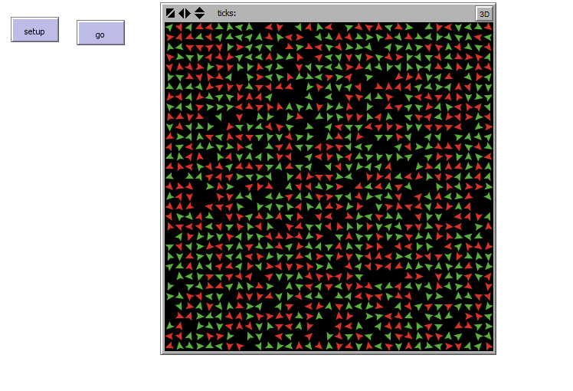
Advance the System “go”
Create a button named go
Do not advanced the system if all the agents are happy
Move unhappy agents to new locations
Update the global variables and turtles variables
Notes:
Notice how clicking go advances the tick counter and nothing elese. Now lets fix this

Slide 35
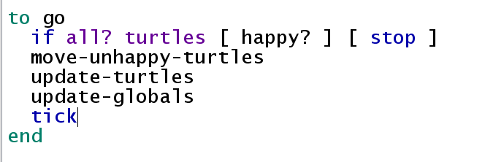
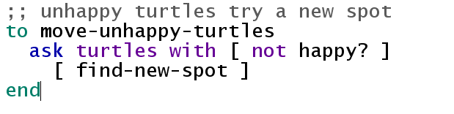
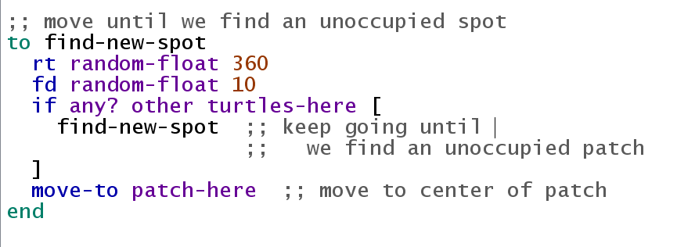
Notes:
fd: move forward in this example 10 steps i.e. moves 10 steps
rt turn any direction, could be set to 90 to turn right etc.

Slide 36
Sliders
The density and percent-similar-wanted can be controlled by interface widgets
Sliders can be used to control their values
Select interface tab
Click on “Add” and select “Slider” instead of button.
Click on the canvas below set up to create the slider
Global Variable: percent-similar-wanted
Units: %
There is an error !!
Let’s fix it
Comment out “percent-similar-wanted” in the code (i.e. globals)
Experiment on different values of percent-similar-wanted
Notes:
comment out

Slide 37
Slider for Density
The density can be controlled by interface widgets
Sliders can be used to control their values
Select interface tab
Click on “Add” and select “Slider” instead of button.
Click on the canvas below set up to create the slider
Global Variable: density
Units: %
There is an error !!
Let’s fix it
Comment out “set density 90” in the setup procedure
Experiment on different values of the densities

Slide 38
Positioning the View
Right click on the View and select “Select”
To adjust the location of the View, place the mouse at one corner of the View, hold and drag the View toward the center of the canvas
To move the sliders or button, right click on one of them and choose “Select”

Slide 39
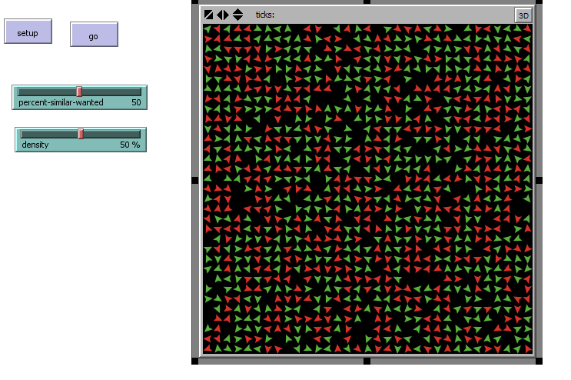
The Interface Should Look Something Like This

Slide 40
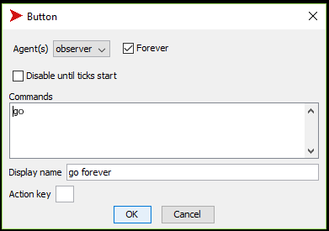
Go Forever
Create a new button
Give it a “go” command
Name it “go forever”
Check mark forever
Experiment on the difference between this button and the other go button

Slide 41
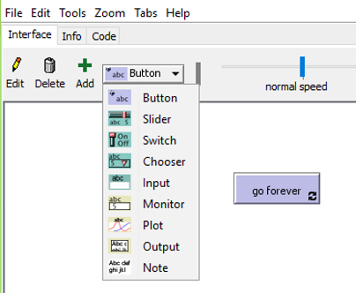
Plot the Number of Unhappy Turtles
Select Interface tab and add Plot

Slide 42
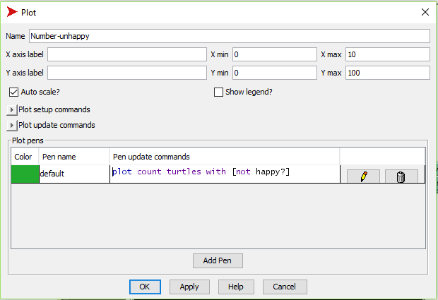
Plot the Number of Unhappy Turtles
Select Interface tab and add Plot
Name : Number-unhappy

Slide 43
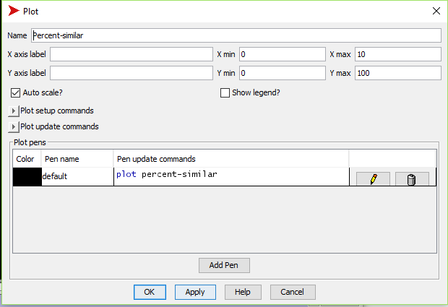
Plot the Number of Percent similar
Select Interface tab and add another Plot
Name : Percent Similar
Pen update command: plot percent-similar

Slide 44
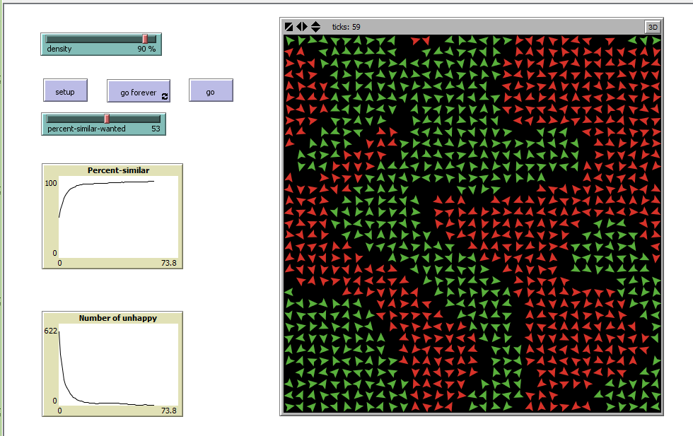
Run the Model

Slide 45
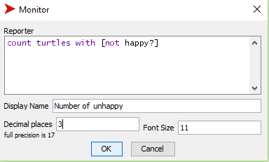
Monitor the Number of Turtles
Monitors are another means of displaying information from a model.
The same way we added the button the sliders and the plot, select the “Monitor”
Display name: Number of unhappy
Reported : count turtles with [ not happy? ]
Decimal places: 3
Click “OK” to close the monitor
Repeat the process to show the turtle count etc.
i.e. count turtles, percent-unhappy
Notes:
Number of turtles: count turtles
Count no unhappy: count turtles with [not happy?]
% unhappy: percent-unhappy

Slide 46
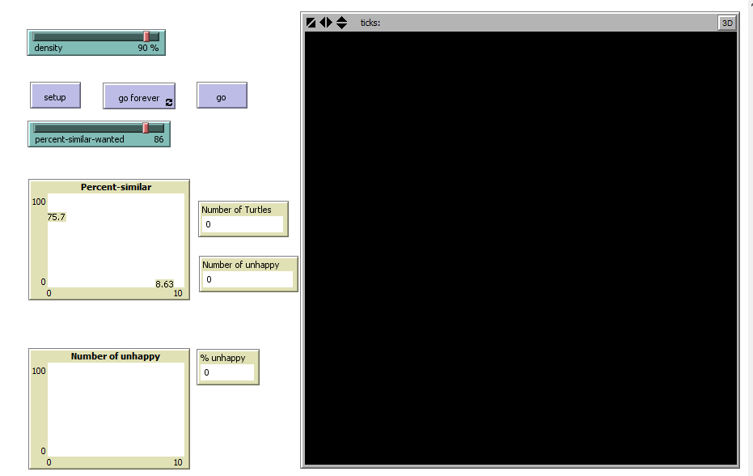
What the Model Should Look Like Now

Slide 47
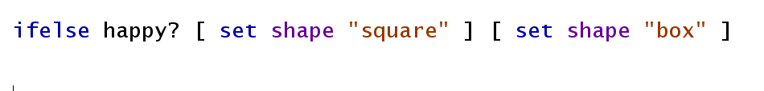
Improved Visualization
We need an option to distinguish unhappy agents from the others
Add the following code to the update-turtles procedure
Notes:
Square is happy
box is not.

Slide 48
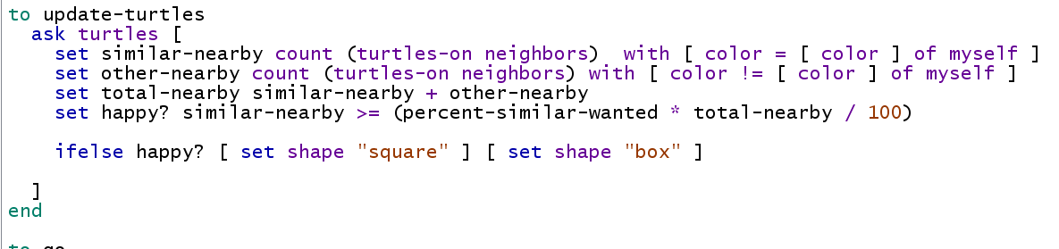
Improved Visualization
We need an option to distinguish unhappy agents from the others
Add the following code to the update-turtles procedure

Slide 49
Improved Visualization
We need an option to distinguish unhappy agents from the others
Add the following code to the update-turtles procedure
Go back to Interface tab and click on set up

Slide 50
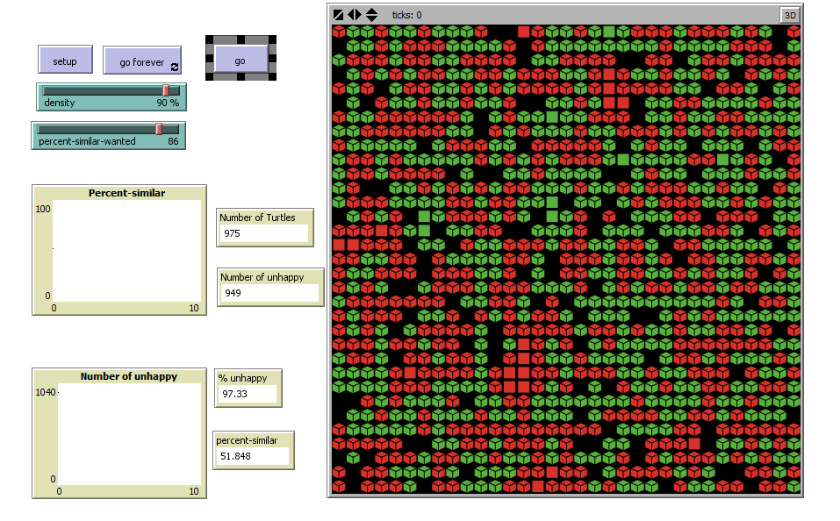

Slide 51
That’s it!
Now you can experiment with how density and %-similar-wanted impact the model results……..

Slide 52
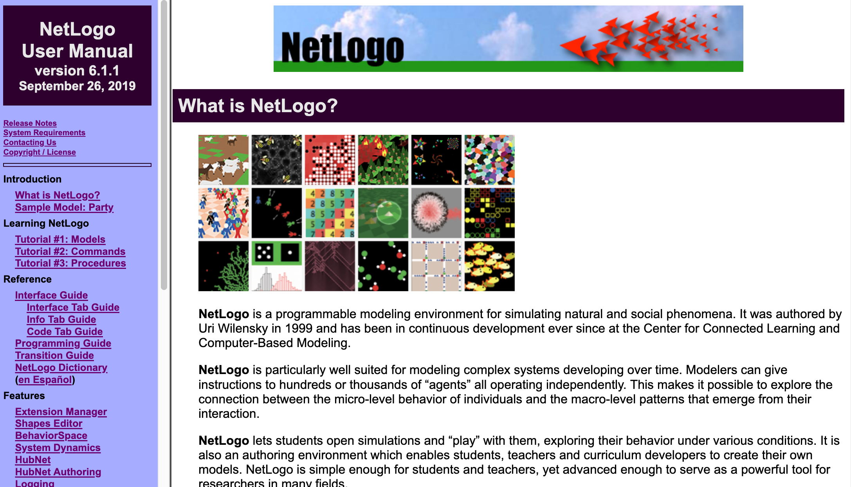
More Information
http://ccl.northwestern.edu/netlogo/docs/

Slide 53
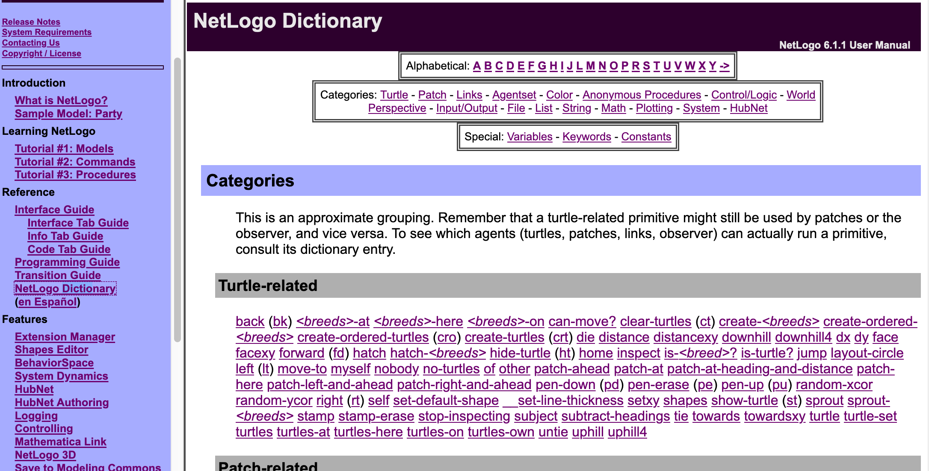
More Information (cont)
http://ccl.northwestern.edu/netlogo/docs/dictionary.html

Slide 54
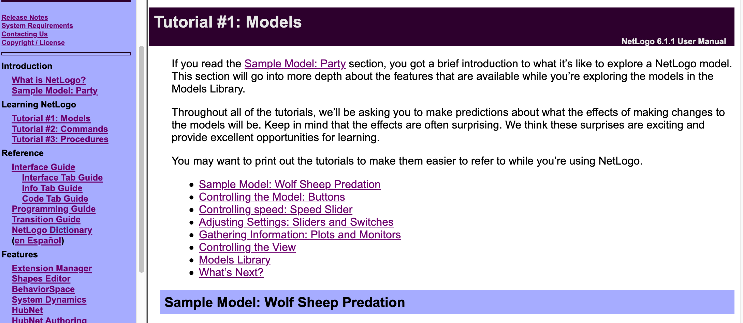
NetLogo Tutorials

